Slide 1
open vswitch with DPDK: architecture and performance
July 11, 2016
Irene Liew

Slide 2

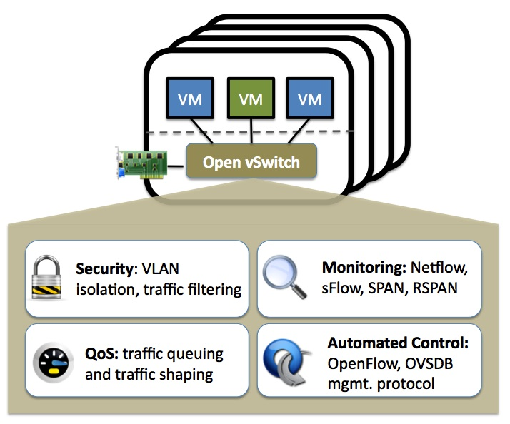
OpenVswitch (OVS)
A software-based solution
Resolve the problems of network separation and traffic visibility, so the cloud users can be assigned VMs with elastic and secure network configurations
Flexible Controller in User-Space
Fast Datapath in Kernel
An implementation of Open Flow
community project offered under the Apache 2.0 license
OVS release 2.5.0 available for download
Intel Open Network Program selected OVS as Intel open virtual switch
Visit: http://openvswitch.org/
to learn Why OVS
Notes:
There are many different virtual switching solutions. Many target specific requirements and use cases.
Open vSwitch is a production quality, multilayer virtual switch licensed under the open source Apache 2.0 license.
It is fully featured and supports SDN control semantics via the Open Flow protocol and its OVSDB management interface.
It is available for the openvswitch.org website but is also consumable through Linux distributions.

Slide 3
open vswitch with DPDK architecture

Slide 4
NATIVE Open vSwitch – architecture
User Space
Main forwarding plane runs in kernel space
Exception packets are sent to vswitchd in userspace using Netlink
Standard Linux network interfaces to communicate with physical network
ovs-vswitchd
Netlink
Kernel Space
OVS Kernel Space Forwarding Plane
(openvswitch.ko)
NIC
NIC
NIC
Notes:
This is the architecture of OVS with the kernel space datapath.
For the most part, packets that are forwarded between NICs (or Virtual NICs) do so in the kernel space datapath. The kernel datapath consists of a simple flow table indicating what to do with packets that are received. Only exception packets (first packet in a flow) need to go to userspace as they do not hit any entries in the simple table in the kernel datapath. After userspace handles the first packet in the flow, userspace will then update the flow table in kernel space so that subsequent packets in the flow are not sent to userspace. In this way, the number of kernel space flow table entries is reduced and the number of packets that need to traverse the computationally expensive userspace path is reduced.

Slide 5
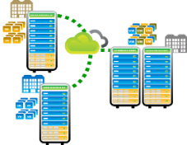

Virtual Switch Requirements – Enterprise vs Telco
Enterprise Data Center
Telco Network Infrastructure
Manageability
Console
Larger Packet Mix for Endpoint Use
10G connectivity
Software only switching
Out-of-box platform software
Mainstream hardware features
Live Migration Typical
Smaller Packets in Network Switching
40G connectivity and greater
Software augmented with hardware
Custom platform software
Network Functions Virtualization
Low jitter/latency
Lower Downtime (aggressive migration)
OVS Kernel datapath gives adequate performance in many cloud and enterprise use cases
However, the performance is not sufficient in some Telco NFV use cases
Notes:
Initial implementations of virtual switches were targeted towards Enterprise and Cloud data centre deployments. As a result, the performance and features that were developed tended to focus on this use case
With the move towards Network Functions Virtualization (NFV), Virtual Network Functions (VNFs) are getting deployed on Standard High Volume (SHV) Servers. As a result, this imposes new feature requirements and more stringent performance requirements on the hypervisor – and, therefore, the Virtual Switch.

Slide 6

DPDK Integration
OVS 2.5.0
Native OVS
User Space
ovs-vswitchd
Integrate latest DPDK library into OVS
Main forwarding plane runs in userspace as separate threads of vswitchd
DPDK PMD to communicate with physical network
Available as a compile time option for standard OVS
Enables support for new NICs, ISAs, performance optimizations, and features available in latest version of DPDK.
OVS with DPDK
Netlink
User Space
Kernel Space
ovs-vswitchd
OVS Kernel Space Forwarding Plane
OVS User Space
Forwarding Plane
NIC
NIC
NIC
DPDK
PMD Driver
PMD Driver
PMD Driver
ace
User Space
Kernel Space
DPDK
NIC
NIC
NIC
PMD Driver
PMD Driver
PMD Driver
Kernel Space
NIC
NIC
NIC
Notes:
In the OVS with DPDK model, the main forwarding plain (sometimes called the fast path) is in userspace and uses DPDK. It is much more performant than the kernel space fast path. Note how the NICs are now PMDs (poll mode drivers). Exception packets are sent to another module in userspace. The exception path is the same path that is traversed by packets in the kernel fast path case.
OVS with DPDK is available in the upstream openvswitch.org repository and is also available through Linux Distributions.

Slide 7
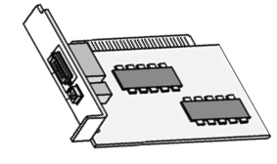
Open vSwitch (OVS) With DPDK ARCHITECTURE
Controller
ovsdb
OpenFlow
Data Path
Control Path
Control Path
Compute Node:
User Space
VNF
virtio
Qemu
ovsdb server
ovs-vswitchd
netdev
netdev_vport
netdev_linux
netdev_dpdk
VNF
virtio
Qemu
ofproto
DPDK librte_vhost
overlays
sockets
dpif-netlink
(Kernel Space Forwarding – Control only)
dpif-netdev (User Space Forwarding)
DPDK PMD
librte_eth
openvswitch.ko
Compute Node:
Kernel space

Slide 8
OVS with DPDK architecture: Structure
ovs-vswitchd
ofproto
Openflow controller
netdev
ofproto-dpif
netdev-dpdk
dpif
vhost
libdpdk
dpif-netdev
User space
vfio
vfio
uio
Kernel space
NIC
Hardware

Slide 9

Open vSwitch (OVS) With DPDK COMMANDS
ovs-vsctl - vswitch management
Control Path
ovsdb server
ovs-ofctl – Openflow management
ovs-vswitchd
ofproto
ovs-appctl – ovs-vswitchd management
dpif-netlink
(Kernel Space Forwarding – Control only)
dpif-netdev (User Space Forwarding)
openvswitch.ko
Data Path
Control Path
Notes:
Ovs-vsctl utility for querying and configuring ovs-vswitchd. ovs-vsctl connects to an ovsdb-server process that maintains an Open vSwitch configuration database. Using this connection, it queries and possibly applies changes to the database, depending on the supplied commands.
Ovs-ofctl administers OpenFlow switches
Ovs-appctl utility for configuring running Open vSwitch daemon

Slide 10
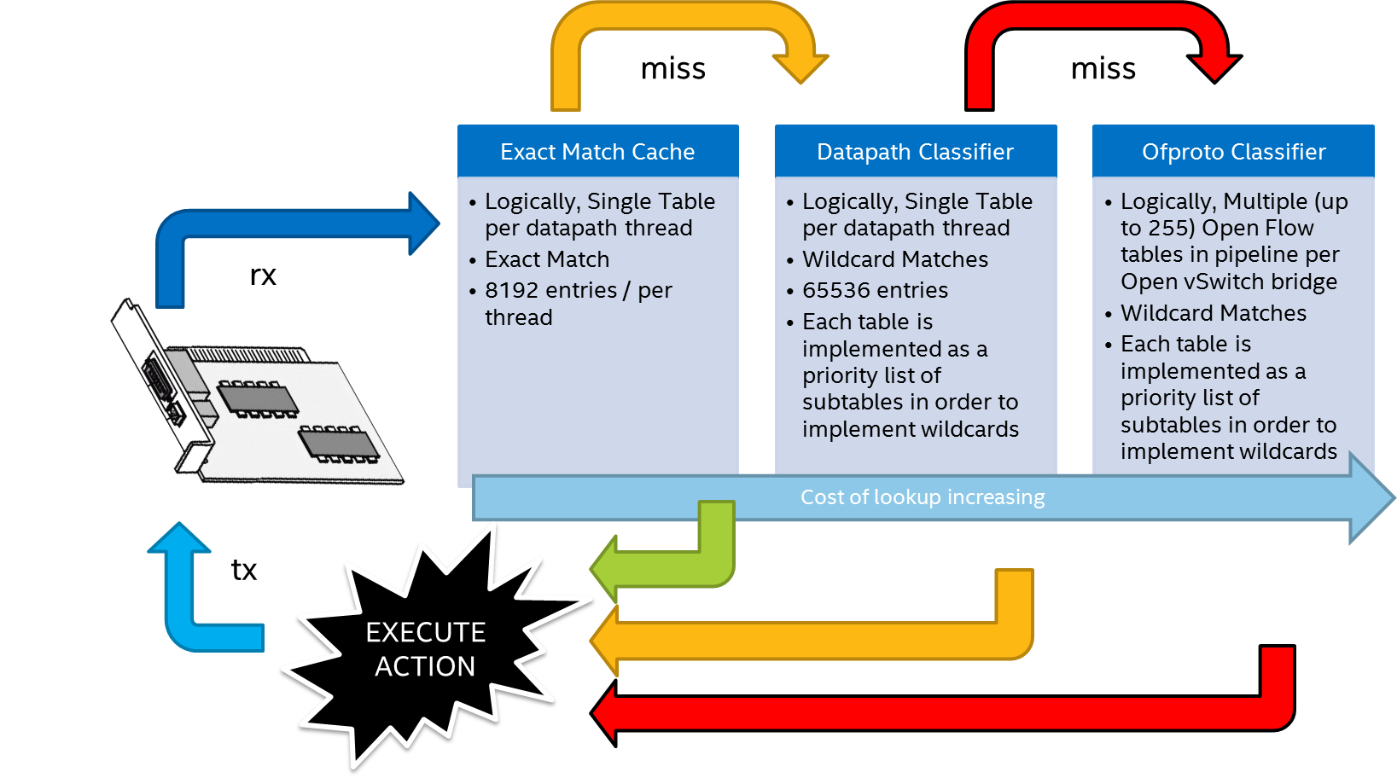
Open vSwitch® with DPDK Processing Pipeline: OPENFLOW
Notes:
OVS consists of a 3-level hierarchy of flow tables. The first level table (Exact Match Caches) is the most efficient and the third level table (Ofproto Classifier) is the least efficient.
When frames arrive, Open vSwitch checks each level to see if a flow is present in the table. If a flow is not present in a table, a miss is generated forcing a lookup to be carried out in the next level table. If a flow is not present in the highest level table (the ofproto classifier), the frame will either be dropped or (if configured) a remote SDN controller will be queried in order to determine what to do with that Frame.
Flows that traverse OVS need to be present in the Exact Match Cache. This cache contains flows that are currently in use. As the table has a limited size, they are evicted from the EMC and the Datapath Classifier by using a Least Recently Used (LRU) policy when the table overflows. In order to achieve the best performance, as many frames as possible need to hit in the exact match classifier.
The structure of the tables is an implementation detail. From a user perspective, OVS presents a fully Openflow compliant switch that allows programming of multiple tables in arbitrary pipelines.

Slide 11
OVS 2.5.0 Summary

Slide 12
Supported features
Vhost multi-queue feature:
Multi-queue support to vhost-user for the DPDK datapath (DPDK-2.2.0 and newer).
QEMU-2.5.0 and newer versions required for multi-queue support

Slide 13
Multiqueue vHost
OVS 2.5.0
VM
Provides way to scale out performance when using vhost ports.
Number of queues configured for vHost vNIC is matched with the same number of queues in the physical NIC
RSS hash used to distribute Rx traffic across queues
Each queue is handled by a separate PMD i.e. the load for a vNic is spread across multiple PMDs
vNic
Q0
Q1
Q2
Q3
Rx
Tx
Rx
Tx
Rx
Tx
Rx
Tx
Guest
vSwitch
PMD 0
PMD 1
PMD 2
PMD 3
Core 1
Core 3
Host
Core 2
Core 4
…
Hardware
NIC
Q0
Q1
Q2
Q3
Rx
Tx
Rx
Tx
Rx
Tx
Rx
Tx

Slide 14
OVS with DPDK Performance
Notes:
Add a slide on the test setup and traffic generator

Slide 15
OVS-DPDK Performance tuning
Enable hugepage size 1GB (64-bit OS) / 2MB (32-bit OS) setup on the host
Isolate cores from the linux scheduler in the boot command line
Affinitize DPDK pmd threads and Qemu vCPU threads accordingly
PMD threads affinity
Use multiple poll mode driver threads. E.g. to run PMD threads on core 1 and 2:
# ovs-vsctl set Open_vSwitch . other_config:pmd-cpu-mask=6
Qemu vCPU thread Affinity
Note: # active threads (with 100 CPU%) are set to different logical cores
Disable RX Mergeable buffers
-netdev type=vhost-user,id=net2,chardev=char2,vhostforce -device virtio-net-pci,mq=on,netdev=net2,mac=00:00:00:00:00:02,csum=off,gso=off,guest_tso4=off,guest_tso6=off,guest_ecn=off,mrg_rxbuf=off
Enable the number of rx queues for DPDK interface (multi-queue)
# ovs-vsctl set Interface <DPDK interface> options:n_rxq=<integer>
VM1 QEMU threads:
Logical Core | Process
3 | QEMU (main thread for VM1)
4 | QEMU
5 | QEMU
5 | QEMU
5 | QEMU

Slide 16
Platform Configuration
Item | Description
Server Platform | Supermicro X10DRH-I http://www.supermicro.com/products/motherboard/Xeon/C600/X10DRH-i.cfm Dual Integrated 1GbE ports via Intel® i350-AM2 Gigabit Ethernet
Chipset | Intel® C612 chipset (formerly Lynx-H Chipset)
Processor | 1x Intel® Xeon® Processor E5-2695 v4 2.10 GHz; 120 W; 45 MB cache per processor 18 cores, 36 hyper-threaded cores per processor
Memory | 64GB Total; Samsung 8GB 2Rx8 PC4-2400MHz, 8GB per channel, 8 Channels
Local Storage | 500 GB HDD Seagate SATA Barracuda 7200.12 (SN:Z6EM258D)
PCIe | 2 x PCI-E 3.0 x8 slot
NICs | 2 x Intel® Ethernet Converged Network Adapter X710-DA4 Total: 8 Ports; 2 ports from each NIC used in tests.
BIOS | AMIBIOS Version: 2.0 Release Date: 12/17/2015
Software Component | Version
Host Operating System | Fedora 23 x86_64 (Server version) Kernel version: 4.2.3-300.fc23.x86_64
VM Operating System | Fedora 23 x86_64 (Server version) Kernel version: 4.2.3-300.fc23.x86_64
QEMU-KVM | QEMU-KVM version 2.5.0
Open vSwitch | Open vSwitch 2.4.9 Commit ID: 53902038abe62c45ff46d7de9dcec30c3d1d861e
Intel® Ethernet Drivers | i40e-1.4.25 Intel® Ethernet Converged Network Adapters X710-DA4
DPDK | DPDK version: 2.2.0 http://www.dpdk.org/browse/dpdk/snapshot/dpdk-2.2.0.tar.gz

Slide 17
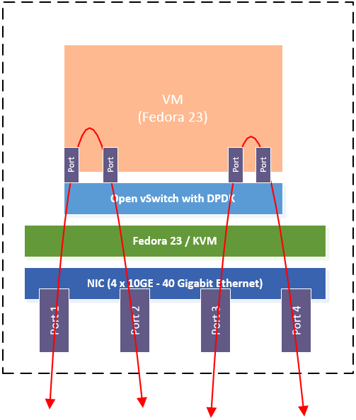
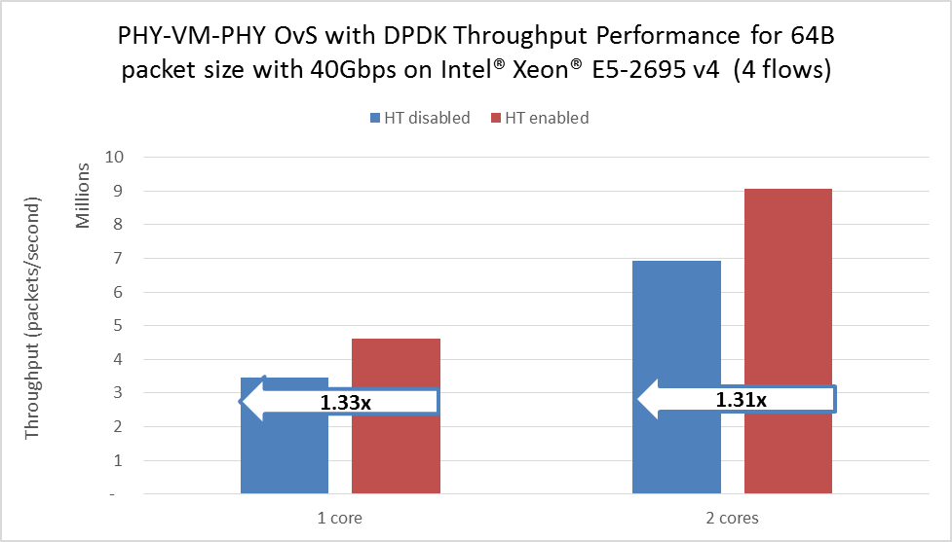
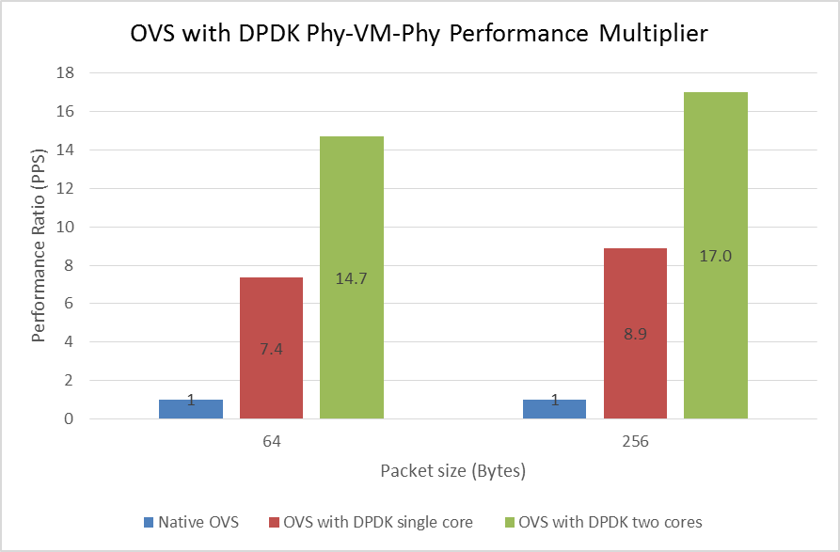
Phy-OVS-VM Performance
Observed performance gain with hyper-threaded core (Hyper-threading enabled)
Core scaling is linear
* Source: Intel ONP 2.1 Performance Test Report
Source: Irene Liew, Anbu Murugesan – Intel IOTG/NPG
Notes:
2 switching operations

Slide 18
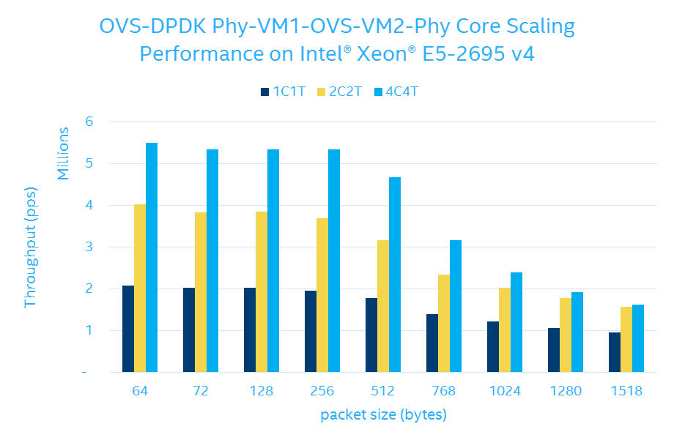
Phy-OVS-VM1-OVS-VM2-OVS-Phy Performance
Core scaling is linear
* Source: Intel ONP 2.1 Performance Test Report
Notes:
^{3 switching operations}

Slide 19
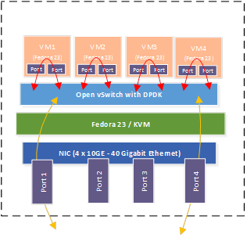
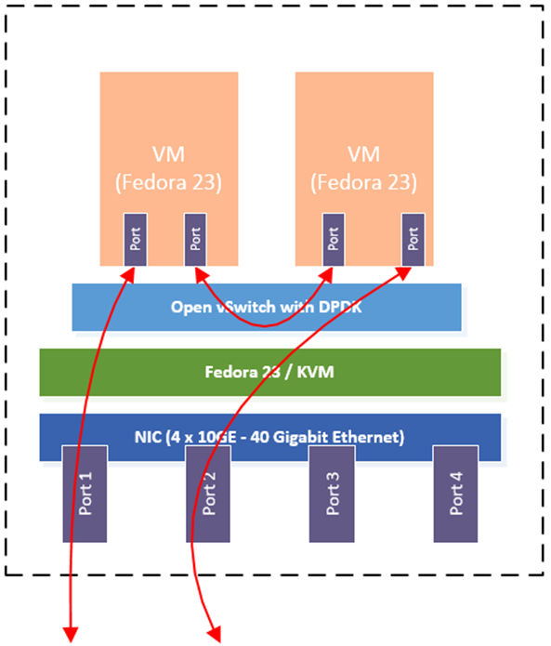
40G Switching performance
Scenario 1
Scenario 3
* Source: Intel ONP 2.1 Performance Test Report
Notes:
Scenario 1: A total of 8 cores are needed to achieve 40 Gbps switching performance for test scenario 1 at 256 bytes packet size. Two cores are used for the switching, while 6 additional cores are used for passing the data to the VMs (i.e. for use by vHost and associated PMD). In this scenario each VM is transmitting and receiving 5 Gbps. The traffic over the wire is 20 Gbps transmit and 20 Gbps receive. Hence the OvS is switching 40 Gbps when accounting for the bidirectional nature of the traffic.
Scenario 3: A total of 6 cores are needed to achieve 40 Gbps switching performance for test scenario 3 at 256 bytes packet size. This scenario is for a simple service function chain of two VMs. The traffic through the service chain is 9.5 Gbps.

Slide 20
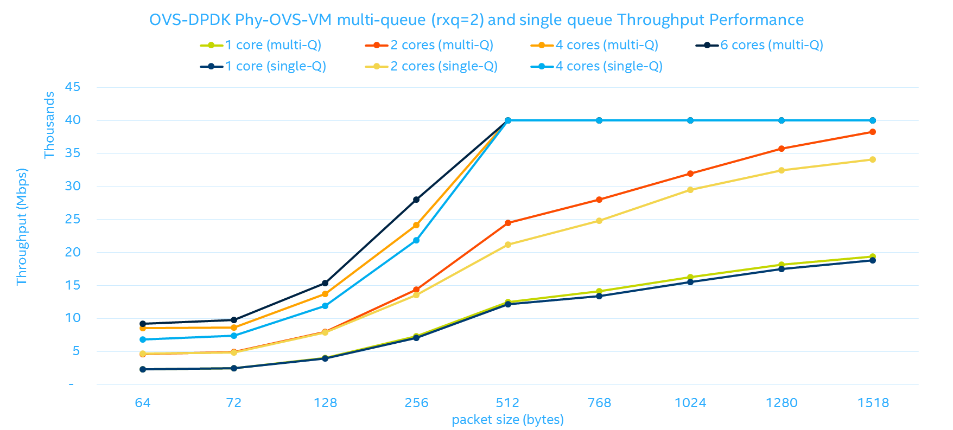
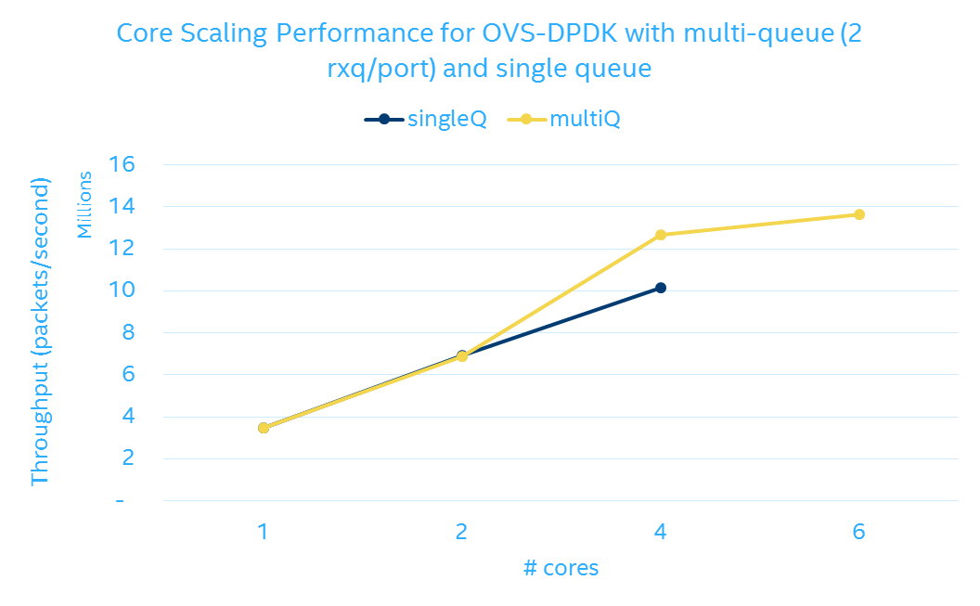
OVS-DPDK: Multi-queue VHOST performance
Benefit of multi-queue can be observed when number of cores assigned for PMD threads align to the RX queues.
Recommend minimum of 4 cores assigned to PMD threads in multi-queue configuration
Notes:
~25% performance gain with 4 cores PMD threads config
multi-queue doesn’t make the RX/TX run faster, actually there’s some overhead moreover. So for instance, you use 1 core for OVS PMD, and increase rxq number, this will hurt performance

Slide 21
ReferenceS
ONP 2.1 Performance Test Report (https://download.01.org/packet-processing/ONPS2.1/Intel_ONP_Release_2.1_Performance_Test_Report_Rev1.0.pdf)
How to get best performance with NICs on Intel platforms with DPDK: http://dpdk.org/doc/guides-2.2/linux_gsg/nic_perf_intel_platform.html
Open vSwitch 2.5.0 documentation and installation guide:
http://openvswitch.org/support/dist-docs-2.5/
https://github.com/openvswitch/ovs/blob/master/INSTALL.DPDK-ADVANCED.md

Slide 22
Legal Notices and Disclaimers
Intel technologies’ features and benefits depend on system configuration and may require enabled hardware, software or service activation. Learn more at intel.com, or from the OEM or retailer.
No computer system can be absolutely secure.
Tests document performance of components on a particular test, in specific systems. Differences in hardware, software, or configuration will affect actual performance. Consult other sources of information to evaluate performance as you consider your purchase. For more complete information about performance and benchmark results, visit http://www.intel.com/performance.
Intel, the Intel logo and others are trademarks of Intel Corporation in the U.S. and/or other countries. *Other names and brands may be claimed as the property of others.
© 2016 Intel Corporation.
Notes:
Place at the back of the deck

